Slide 1


Interviewing for Fit and Potential

Slide 2



This 60-minute interviewing skills session will help you as a hiring manager improve your interviewing skills by incorporating key insights on Al-Futtaim Group’s standard interview process.
Incorporate Structured Interviews process in your interviewing approach
Help Hiring Managers to Combat Bias
Better interviews improve candidate acceptance rates
Better interviews mean better quality hires
Company image and candidate experience
Prelude

Slide 3


Intense
Timed
Tasters
Notes:
Trainer’s notes
“Which has more caffeine the Americano or espresso?”
“They have the same amount.”
“We’re condensing a full day’s training into an hour.”
“It’s just as effective and You get to do other things with Your day.”
“In order to fit everything in:
The session will be intense, we’ll cover a lot of ground
Speedy. Each section will be timed.
And the learning and activities will be in the form of tasters. The real learning happens when You take this new material and start applying it straight away."

Slide 4
Agenda ...
Familiarize you with the 5-step structured Selection & Interview Process
Preparation
Structured Interview Process
2. Setting the scene
3. Asking Competency Based Behaviour Questions
4. Close & Next Steps
5. Rating the Candidate
Notes:
Trainer’s notes.
Set the scene. Ask the room:
“Raise Your hand if as part of Your job You hire people.”
”How did You learn to hire?”
“Chances are that each of us selects people in our own way. Unfortunately, that’s a bad way to hire.”
“The magic of selection is to do it well AND consistently.”
“Today, we’re going to master a great hiring process that each of us should use when we leave the room.”
Share the agenda and flow. “Over the next hour we’re going to cover three sections…”

Slide 5

“Setting the bar high in our approach to hiring has been, and will continue to be, the single most important element of [our] success.”
Jeff Bezos CEO Amazon
1998
Notes:
Trainer’s notes
“Don’t just take my word that hiring matters. This business person thinks so too.”
“What’s especially impressive is when Jeff Bezos said this: 1998”
“The company only went public in 1997 at $18 a share.”
“Great hiring has obviously been integral to Amazon’s success.”
“Their share price is around $1,900 today (July 2019).”

Slide 6

What’s the Impact of a bad hire?
Notes:
Trainer’s notes
Create a poll on MS teams before the program, launch the poll and then move to the next slide to summarize
What’s the Impact of a Bad Hire?
Time and energy managing poor performance
Drain on productivity from disrupted projects and lack of continuity of work
Impact on team morale and stress
Risk of diminished customer service
A recent study shows that high performers leave due to low performers staying long in the team !
All of the above
Show the poll “What’s the cost of a bad hire?”

Slide 7
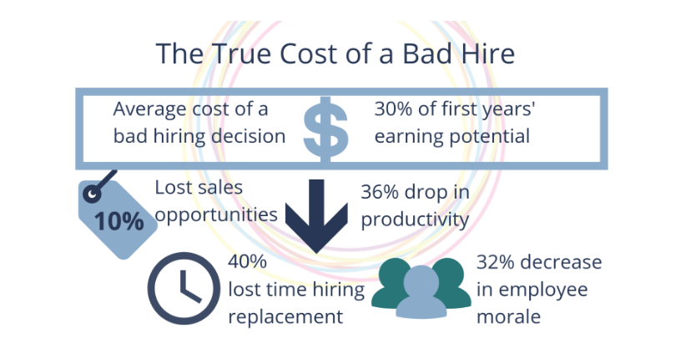

It is estimated that a bad hire can cost a company at least 30% of the employee's annual salary, depending on position, seniority, industry

Slide 8




A bad hire doesn’t mean a bad person…it means the candidate was not a fit for the role or the team!

Slide 9
Let’s now look at which of the following selection methods have high and low predictability of selecting the right candidate
Resume
References & Recommendations
assessment center
Educational background
mental ability
Gut Feelings
Previous experience for competitors
Knowledge based questions
Notes:
Trainer’s notes
Ask the room: which of the following selection methods have high Predictability of selecting the right candidate?
Later introduce the concept of a Structured Interview

Slide 10


Move the statements on your Near Pod window under Low and High predictability for hiring
Notes:
Create a Matching Paris on Nearpod and save it before launching it for this activity with the words & phrases on slide 7.

Slide 11
Low Predictability | High Predictability
Resume | Structured Interview
References & Recommendations | Assessment Centre
Educational Background | Psychometric assessments
Unstructured interview | Behavior based questions
Gut Feelings
Knowledge based questions

Slide 12

think…
Think…about a bad job interview that you or your friend has experienced in the past, What did they tell you? Or if you experienced it, what did you feel?
Notes:
Trainer’s notes
Ask the room
Real-life horror stories are what You want to hear.
Share a personal horror story and relate it back to how the company images get’s impacted due to a hiring manager who wasn’t trained on interview skills.

Slide 13
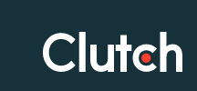


91% of people say their view of a company is influenced by the interview process, and people are 6 times more likely to tell others if they have a negative experience.
‘A candidate-driven market’ is that strong candidates have multiple options
The interview process is not just the candidates’ means of representing themselves to the company, but the company’s way of representing themselves to the candidate…and more than that – to the wider world too.
Notes:
Trainer notes: This research has been shown by Clutch a world’s leading recruitment firm and validated by LinkedIn, Showing an awareness of this throughout the recruitment process is vital for representing a company in the best light, but also for securing the very best talent.

Slide 14

Begin the 5 Steps to structured Selection & Interview process
Preparation
Structured interview process
2. Setting the scene
3. Asking Competency Based Behaviour Questions
4. Close & Next Steps
5. Rating the Candidate
Notes:
Trainer’s notes
“Let’s now begin the journey of the 5-step structured Selection & interview process.

Slide 15

Before you begin the structured interview process…
Reviewed the CV & Job description
What is the success profile of the candidate for the role?
Key deliverables and 3 key priorities
Define which competencies are going to be most critical for the role Technical & Behavioural
Write down the questions you would like to ask.
Have your interview feedback form/ system ready to capture observations.

Slide 16

Preparation
Structured interview process
2. Setting the scene
3. Asking Competency Based Behaviour Questions
4. Close & Next Steps
5. Rating the Candidate
Notes:
Trainer’s notes
“Give a warm welcome. Or how to be a great ambassador for our Company.”

Slide 17

Be on time & Give a warm welcome
Be in a positive frame of mind, smile and meet in an inviting space. Offer a beverage.
Silent mode or Turn off Your phone.
Help the candidate settle. “How was Your journey.” “I know that school.” “Working there must have been fun.” etc.
Explain the interview process, and what they should expect during the interview.
Briefly introduce Al-Futtaim, the division and the role before asking questions.
Setting the Scene
Give the candidate your undivided attention
Notes:
Trainer’s notes
Trainer’s notes
“Get the best of out of the candidate. Put them at ease. Show them they matter.”
“You’re not testing for calmness in an interview situation, You want to find out if they can do the job well and fit the culture.”
“When introducing our Company and the job, don’t speak for longer than two uninterrupted minutes.”
“It’s unappealing and the important information You are giving is hard to take in.”
“Pause, ask a question or check for understanding.”

Slide 18


2
3
4
5
6
1
Which candidate do you think can sell be a real estate consultant?
Notes:
Trainer’s notes
You need to hire a Sales Consultant who needs to be present to sell a new digital washing machine, who do you think looks like someone who can pull this off?
“OK, lets switch gears. Now we’re going to discuss how to minimize our biases when hiring.”
“This section isn’t just about making better hiring decisions; it’s about making the world a fairer place.”
So that brings us to our next question, how can you assess which of these candidates can fit the job profile of a real estate consultant?
Show the next slide of Unconscious Bias

Slide 19
In the hiring process, unconscious bias happens when you form an opinion about candidates based solely on first impressions
2
3
4
5
6
1
Unconscious Bias : Interviewer

Slide 20

Preparation
Structured interview process
2. Setting the scene
3. Asking Competency Based Behaviour Questions
4. Close & Next Steps
5. Rating the Candidate
Notes:
Trainer’s notes
“Now we get to interview!” have a look at the following video where the interviewer confuses experience with future performance! And avoids asking behavior-based questions but rather asks confirmatory questions to convince herself and the voice in her head.
How to conduct a behavior-based interview? Please log-in to your LinkedIn Learning account and show them the video (3mins 57 sec) of How to Conduct a Behavior based interview from the course Interview Techniques.
https://www.linkedin.com/learning-login/share?account=2090924&forceAccount=false&redirect=https%3A%2F%2Fwww.linkedin.com%2Flearning%2Finterviewing-techniques-2019%2Fhow-to-conduct-a-behavioral-interview%3Ftrk%3Dshare_video_url%26shareId%3DyGg3RJYAQ3yZgDpGHbzbyw%253D%253D

Slide 21
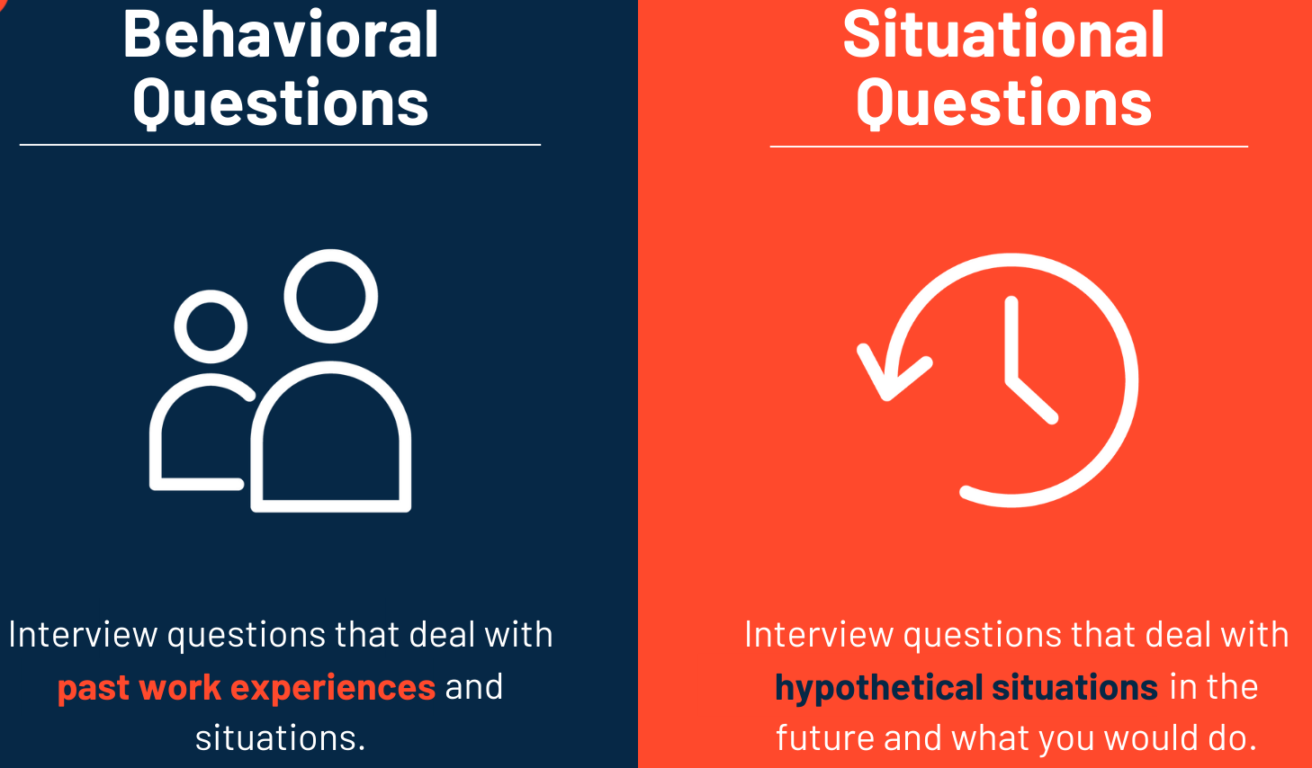
Behavioral Based Interviewing is built on the premise that past behavior predicts future behavior.
The Behavioral based Interview is a systematic way to understand how the candidate behaved in past specific situations.
It helps assess the likelihood for a candidate to be successful in the role based on information the candidate provides .
What is Behaviour-based Interviewing?

Slide 22
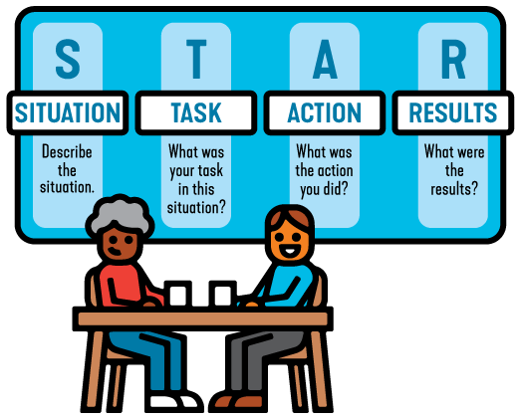
The STAR method is a technique used to prompt candidates to give specific examples of how they've handled past situations or challenges; using this method ensures we get objective responses that help us minimize gut feeling decisions and give us an insight on how the person thinks and how they apply themselves at work.
It also helps you drill down into the details, which help you gauge how authentic the candidate is being.
STAR Technique f Interviewing questions
Notes:
The STAR interview method is way to structure a behavior-based interview question, by asking the candidate the specific Situation, Task, Action, and Result of a previous experience or situation related to their job.

Slide 23
WHAT? | HOW?
What was your role? What did you do? What do you mean? What did that look like? What was the impact/result? What is a good example of that? What was your biggest mistake? What was your biggest failure? What targets did you miss? What did your boss say? What did your boss say when you announced your resignation? What motivated you? What about that was hard? What didn’t you enjoy doing? What parts of the job did you not like? What did you learn? | How did your performance compare to peers? How did your performance compare to the plan? How did your performance compare to the previous year’s performance? How did you do that? How did that go? How long did it take? How did that impact you? How did that impact the business? How did you feel? How much money did you save? How did you deal with that?” How could you have done that better? How did that person react? How did you communicate that?
Follow up Questions to Probe for details - Behavior Based Questions

Slide 24

STAR method to interview a candidate.
Notes:
https://www.linkedin.com/learning-login/share?account=2090924&forceAccount=false&redirect=https%3A%2F%2Fwww.linkedin.com%2Flearning%2Fhiring-an-employee-for-managers%2Fbehavioral-based-interviewing%3Ftrk%3Dshare_video_url%26shareId%3DpXBQwCzXQQqQvJ9exti7OQ%253D%253D

Slide 25

Are you a team player?
Tell me about a time when you oversaw a task or project, describe your leadership style
We have a situation where the custom wants to access information digitally, how would you make that available?
What was your greatest challenge in a particular leadership role you have had?
What idea have you developed and implemented that was particularly creative or innovative?
What characteristics do you think are important for this position?
Which Qs are Behavior Based?
Notes:
Trainer’s notes
Let us know understand what does the Behaviour based interview mean?

Slide 26
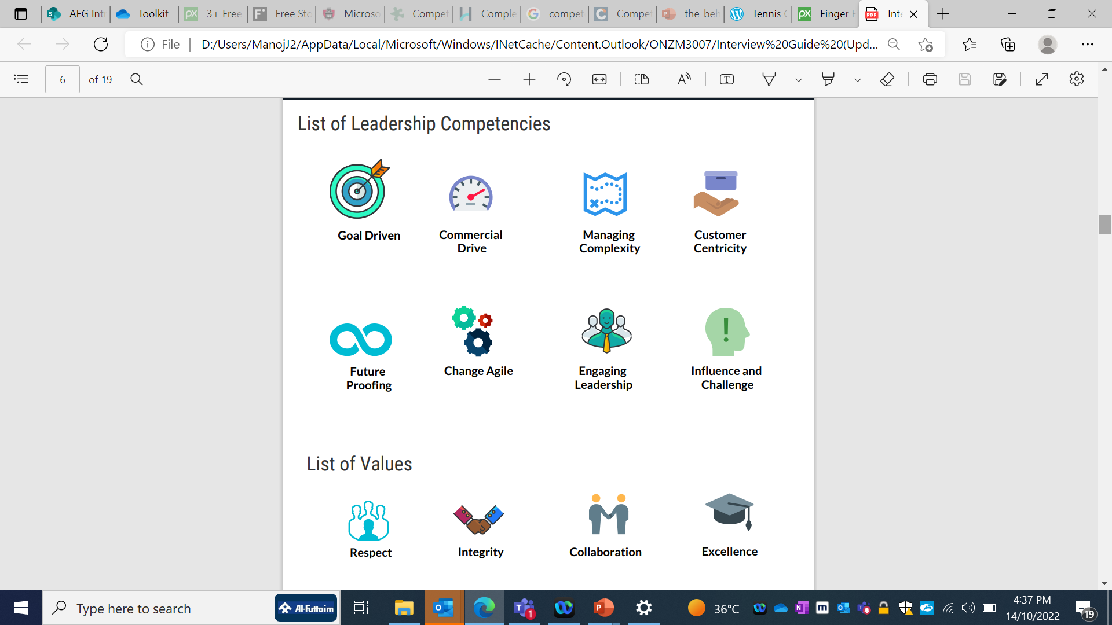
Prioritize which Competencies are critical for success, and ask questions to understand the behaviours the candidate would have demonstrated in the past around these competencies.
Always ask for a real NOT a hypothetical event.
E.g. Tell me about a time when you where challenged in influencing a key stakeholder.....
NOT
What would you do to influence a key stakeholder?
Values & Competency Based Assessment
Notes:
In this slide we understand the importance of deciding which competencies that we would like to focus on interviewing the candidate.

Slide 27



Similarly think about what technical capabilities are critical for success in this role.
Understand how the candidate approaches such tasks
E.g. Capability to operate under pressure
Go back to a time where you were accountable to deliver on a project, which was getting repeatedly delayed...or had an unexpected budget cut...how did you manage the situation
Technical Competency Based Assessment
Notes:
In this slide we understand the importance of deciding which competencies that we would like to focus on interviewing the candidate.

Slide 28
The quality and quantity of responses are based on the type of questions you ask!
Closed
STAR QUESTIONS
Probe
Reconfirm

Slide 29
Which of the following sensitive questions can be asked?
Notes:
Trainer’s notes
Create a poll on MS teams before the program, launch the poll and then move to the next slide to reveal the answers.

Slide 30


What questions to ask not to ask ?
What kind of questions are you not allowed to ask
Questions around age, ethnicity, sexual orientation or religous beliefs
Questions about their future to becoming parents
Finacial status
Disabilities (unless their job requires physcial requirement )
We beleive in asking open ended questions
What, How, Tell Me More.....
Ask for examples – encourage candidates to be specific!
Be interested – dig a little deeper, don‘t accept generic phrases
Don’t use your own judgement, actively listen
Allow for silence
Repeat back what the candidate has said to ensure you understand

Slide 31

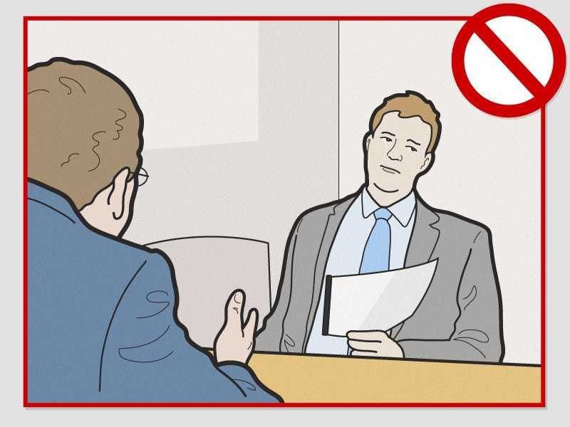
What interviewer distractions do candidates notice?
Doesn't maintain eye contact, Picks phone calls
Seems Distracted & has negative body language
Frequent interruptions, cut’s the interview short
Don’t listen & frequently ask the candidate to repeat
Don’t listen & frequently ask the candidate to repeat
Uses the incorrect resume & ask’s candidate’s name
Staring at Female candidates in-appropriately

Slide 32

Preparation
Structured interview process
2. Setting the scene
3. Asking Competency Based Behaviour Questions
4. Close & Next Steps
5. Rating the Candidate

Slide 33


Give time for the candidate to ask you any questions
Thank them for their time and interest in the job and Al-Futtaim as their potential employer
Brief the Candidate on the next steps.
Avoid Ghosting….If you say you would give them a call within a few days, then make sure you stick to it.
Close & Next Steps
Notes:
Trainer’s notes
Let us know understand what does the Behaviour based interview mean?
Judi and Abdullah’s picture

Slide 34
Let’s summarize the 5 Steps of Interview Process
Preparation Review the CV & Job description
Key deliverables priorities
Define the competencies and write down the questions
Keep the interview feedback form ready
Setting the Scene (5-7mins)
Be on time & Give a warm welcome
Explain the interview process
Briefly introduce Al-Futtaim
Asking Competency based Behavior Based Questions (15-20mins)
Ask open ended questions using the STAR Methodology Focus on details , individual contribution
Close & Next Steps
Allow candidate time to ask questions
Don’t give feedback
Advice Next Steps Thank them for their time and interest
Rating the Candidate
5 – High evidence. 4 – Moderate to high evidence. 3 – Moderate evidence. 2 – Low to moderate evidence. 1 – Low evidence.
1
2
3
Structured Interview Process
5
4

Slide 35


Preparation
Structured interview process
2. Setting the scene
3. Asking Competency Based Behaviour Questions
4. Close & Next Steps
5. Rating the Candidate
Rating the Candidate

Slide 36

Complete the scoring sheet right after the interview
5 – High evidence.
4 – Moderate to high evidence.
3 – Moderate evidence.
2 – Low to moderate evidence.
1 – Low evidence.
Rating the Candidate

Slide 37
Get back to candidates quickly!

